Slide 1
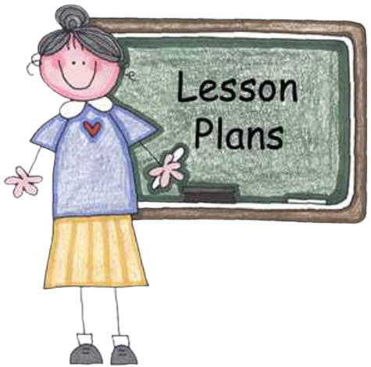
CLICK HERE: Grade 3 Artifact Lesson and Extension Activities
Teachers,
This presentation is intended to help students develop critical thinking skills while learning history content. We recommend that you guide your students through these slides and lesson. Please feel free to use the attached Grade 3 standards-based lesson plan and the extension activities including the Then and Now Venn Diagram and the D.A.T.E. poster.

Slide 2
Artifacts …
Learning at Home
Grade 3
Presented by
DELAWARE COUNTY HISTORICAL SOCIETY
Delaware, OH www.delawareohiohistory.org
© 2020 The Delaware County Historical Society, Inc. I All rights reserved.

Slide 3
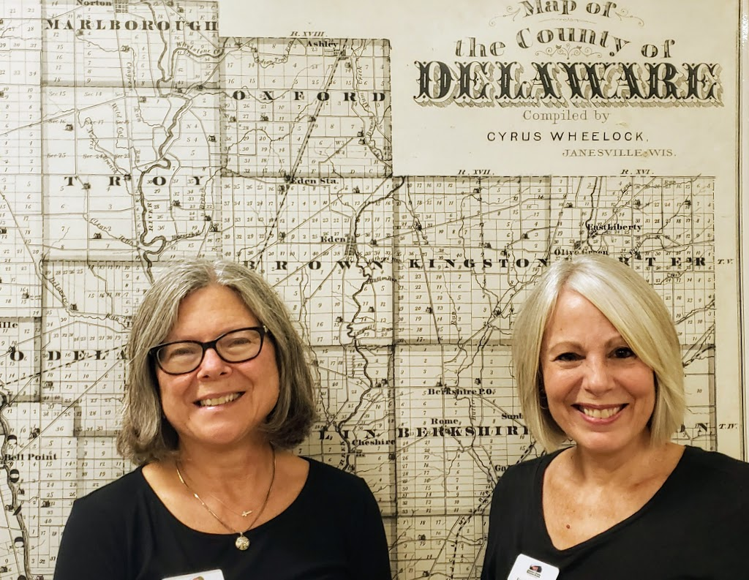
Welcome!
Laurie Schaefer
Roxann Newton
Notes:
BOTH Hello, boys and girls! My name is Laurie, and my name is Roxann. We are volunteers with the Delaware County Historical Society and we’re here today to share some interesting items with you from the past.
These items are called artifacts.

Slide 4
An Artifact
An artifact is “a man-made object: old or new.” Artifacts give us clues as to how people lived, what they may have believed in, and what they used in their environments.
.
Notes:
Laurie Do you know what an artifact is? Did I hear someone say that they are man-made objects? Well, if you did, you are correct! They are things, old or new, that were made by people, and they give us clues about how that person lived, what they may have believed in, and what was used in their environments.

Slide 5
Can you guess what the following items are
or
how they were used?
Notes:
Read slide Then-The artifacts that we have with us today are very old, so you may not know what some of them are or how they were used. Take a guess about each artifact. Use your best thinking skills.

Slide 6
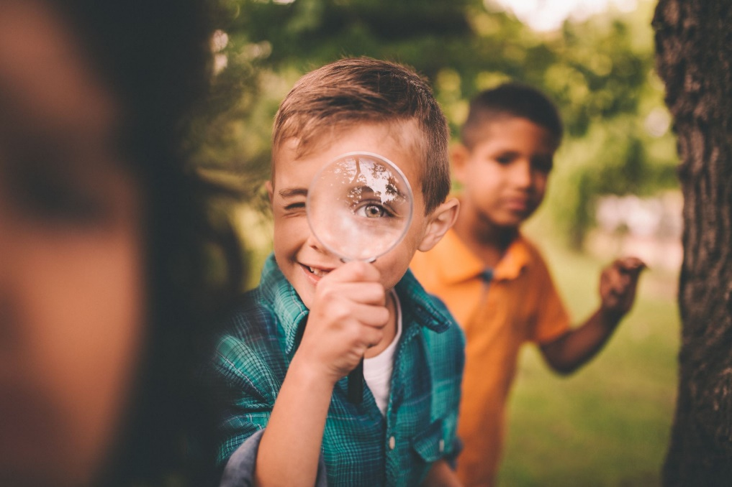
Look closely. The images will give you a clue about the artifacts. What can you conclude or infer from the visual clues?
Notes:
Roxann read slide first and then: Once you make your guess, can you conclude or figure out what the object is? Use your good reasoning skills to make a guess. What have you concluded about your artifact?
TEACHER NOTES:
Inference and draw conclusions–ELA standards Conclude from image- SS standard
(K-12) (Grade 2)
Ohio’s Learning Standards. Social Studies-Adopted 2018. History Strand- Topic: Historical Thinking Skills- Draw conclusions
(K-8)

Slide 7
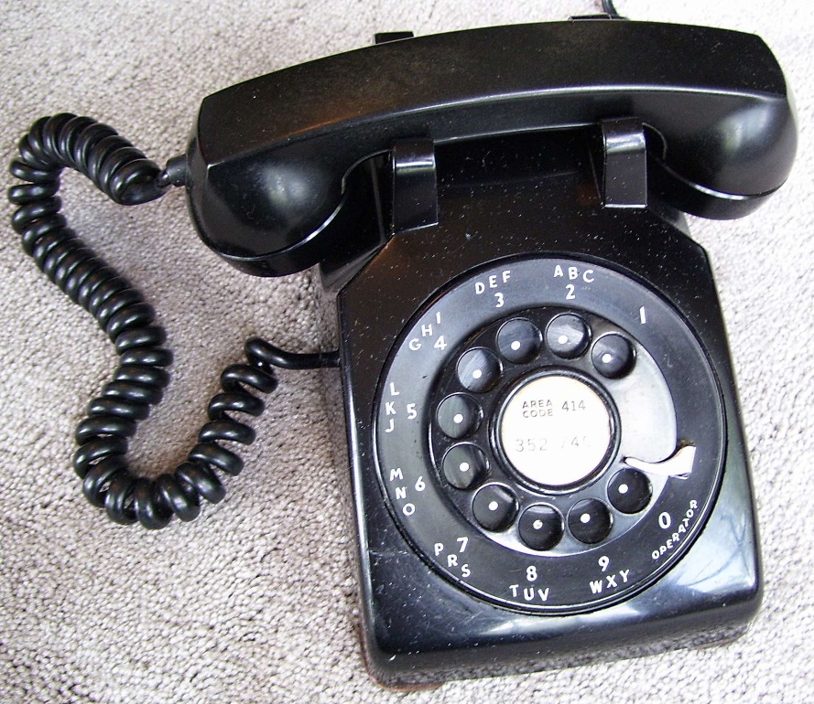
Let’s Practice!
1. DESCRIBE THE ARTIFACT-Can you describe the different parts of this object?
2. ANALYZE ITS PURPOSE How do you think this was used? What are the different parts?
3. TELL ITS SOURCE-Who made this? Where would I find this?
4. EXPLAIN ITS MATERIALS-What materials were used to make this object? Do we use those materials today?
What is your guess or conclusion?
Notes:
Laurie (Read slide)

Slide 8
D.A.T.E. Thinking Routine
Making your Thinking Visible
1 Describe Artifact 3 Tell Its Source
Do you know what this is?
Who do you think this came from?
Do you know what this is called?
Do you know where I could find this?
Who do you think would make this?
2 Analyze Its Purpose
4 Explain Its Materials & Components
How do you think this was used?
Do you know what this is made of?
What might I do with this?
What materials were used?
Have you ever used anything like this?
How is this different from what we may use today?
Notes:
Roxann Here are steps that will guide your thinking as you look at each artifact. Let’s read through these steps. (Read through the poster}
So, using these steps did you guess that this artifact is a telephone from long ago?
TEACHER NOTES: This Thinking Routine is based on VTS or Visible Thinking Strategies developed by Abigail Housen and Philip Yenawine in 1997. The research by the Isabel Steward Gardner Museum and Harvard’s Project Zero supports this as a simple but effective protocol to teach students how to address something new whether it is in art, history, science, ELA or general life skills. They learn to provide evidence for their thinking which develops critical thinking skills. You may wish to print this to hang in your classroom to guide their thinking while learning the steps. Ask the question and let the students respond. You needn’t correct their suggestions, but respond with “Okay” or “What makes you say that?” Students hear what their peers are thinking and learn that we do not always think the same thing when given the same information. They also learn to evaluate their peers’ comments and agree or disagree silently or aloud.
VTS https://vtshome.org/research/
Isabel Stewart Gardner Museum research https://vtshome.org/wp-content/uploads/2016/08/3Gardner-Museum-Thinking-Through-Art.pdf
Eighth Grade School Partnership with VTS program research https://vtshome.org/wp-content/uploads/2016/08/13-Adaptation-Final.pdf
Harvard’s Project Zero Research and additional thinking routines used across grade levels and domains https://pz.harvard.edu/thinking-routines

Slide 9
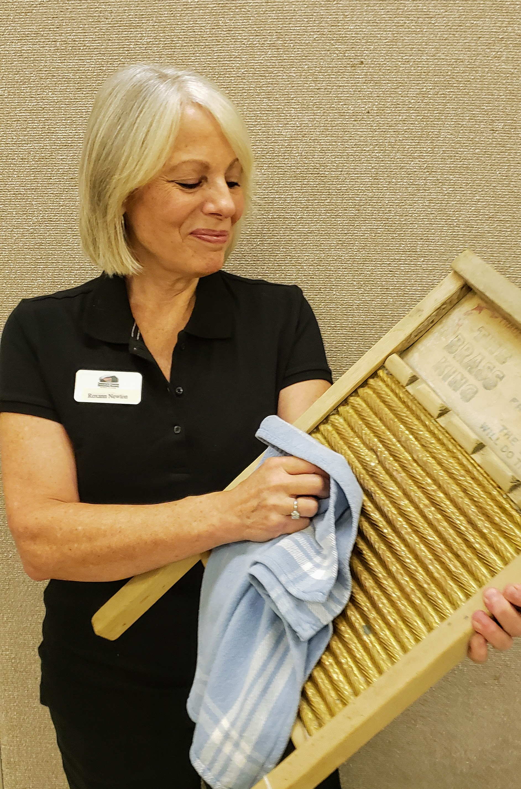
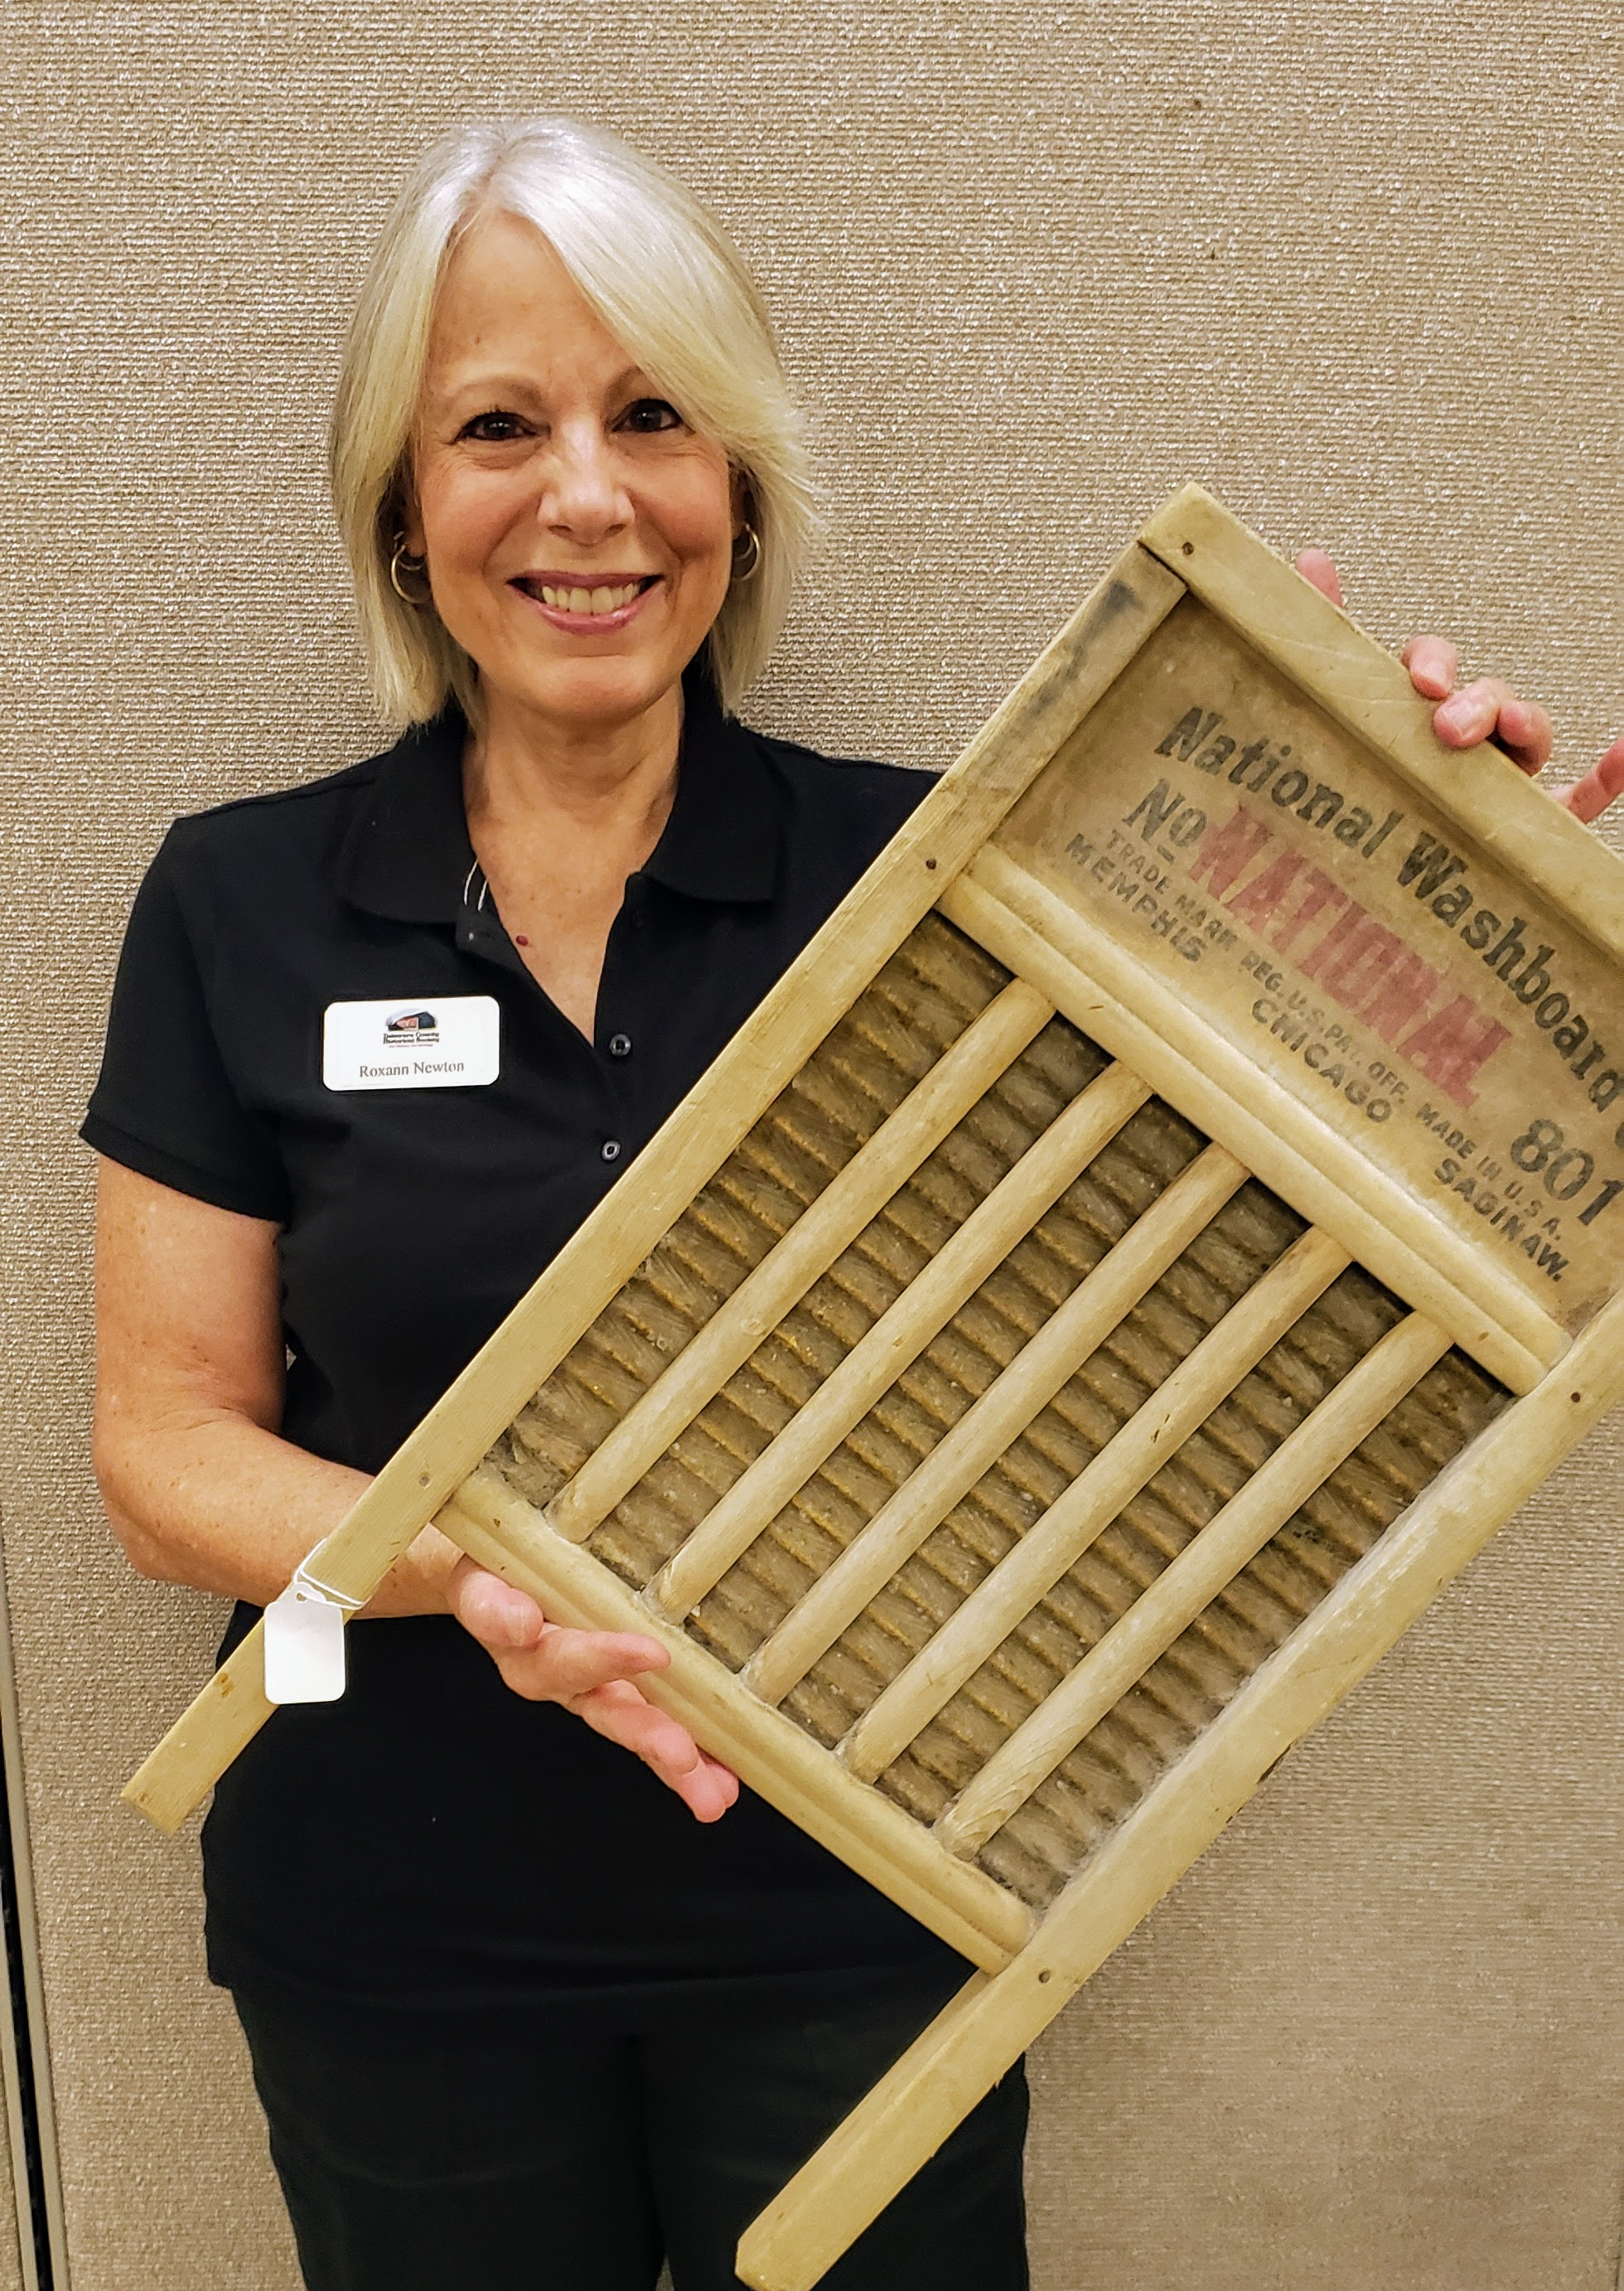
DESCRIBE THE OBJECT
ANALYZE ITS PURPOSE
TELL ITS SOURCE
EXPLAIN ITS MATERIALS
Notes:
Keeping these questions in mind, let’s look at our first artifact.
Let’s Describe the artifact. Let’s Analyze its purpose. How do you think it may have been used? Let’s tell its source or where it came from, or where we could find it. Let’s Explain what materials were used to make this. Now, using the information you have discovered, what did you infer or conclude about this artifact? What were some of your guesses?
Here are some clues. It was used by women or children.
It might be used outside or in the kitchen.
It would be used once a week.
What are some of your guesses or inferences? What was your conclusion?

Slide 10
Wash Board
Wash boards were used before washing machines were invented. Clothes were
scrubbed by hand in a big tub.
Notes:
Did you guess it was a wash board?

Slide 11
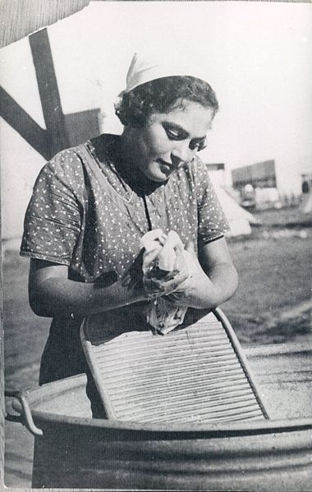
Compare these two photos.
Notes:
Look at these two photos. One of these is from the past and one of them is from today. How are they different? How are they similar?
https://commons.wikimedia.org/wiki/File:PikiWiki_Israel_27878_The_Religious_Kibbutz_Movement.jpg

Slide 12
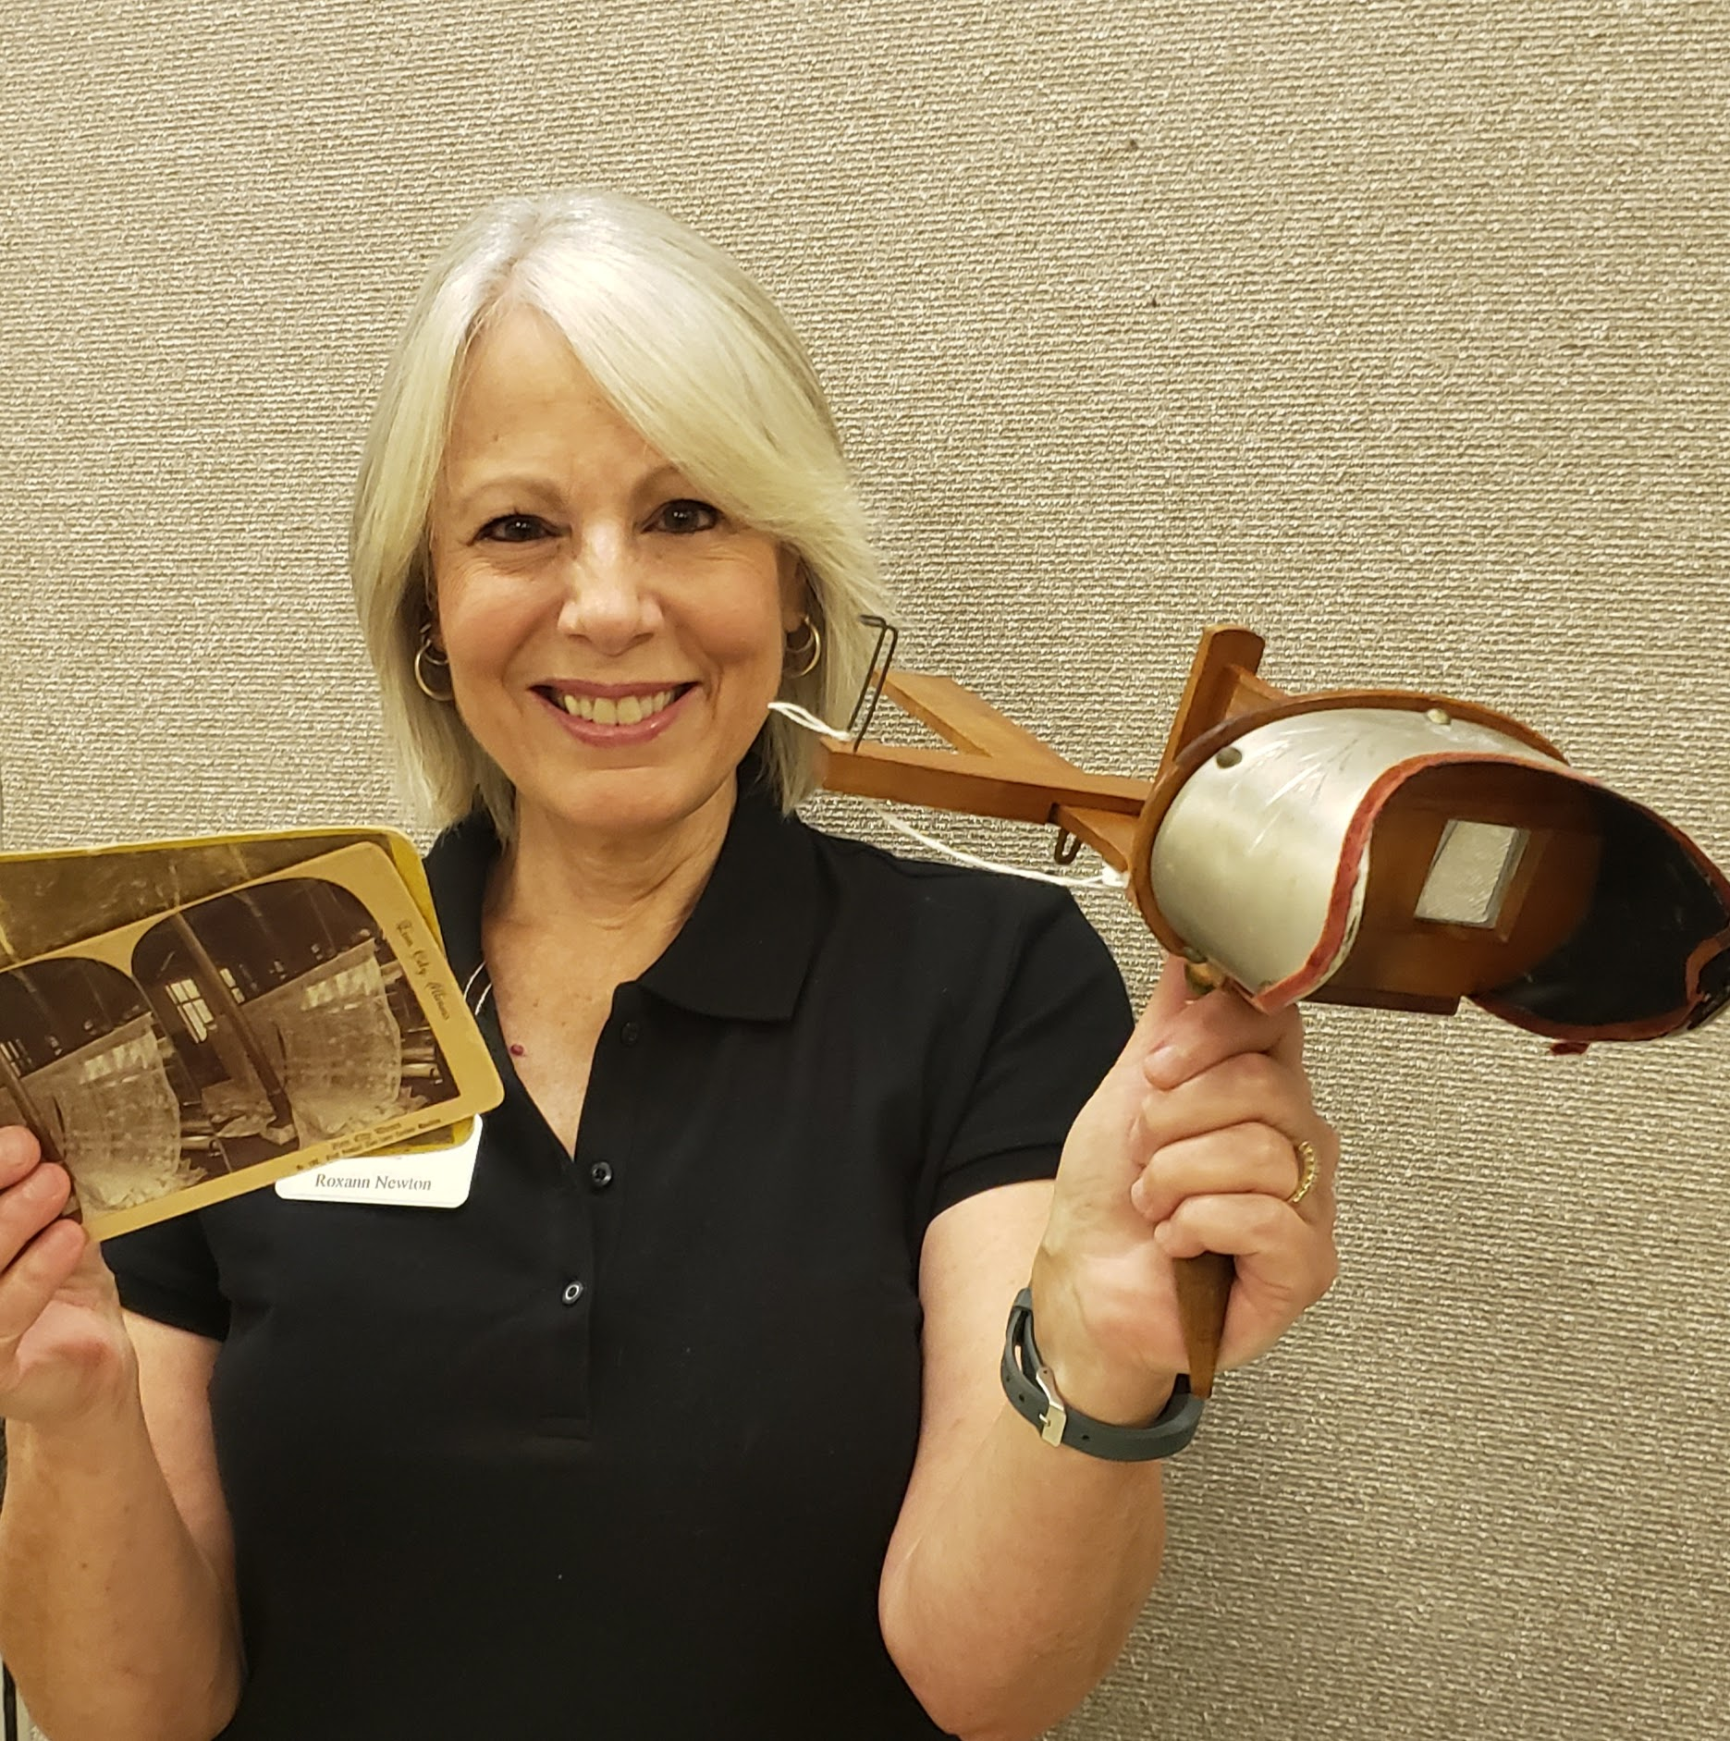
DESCRIBE THE OBJECT
ANALYZE ITS PURPOSE
TELL ITS SOURCE
EXPLAIN ITS MATERIALS
Notes:
Here is our next object. Do you know what it is? Describe it. Analyze its purpose or how it was used. Tell its source. Explain its materials. Here is a clue. It was used as a form of learning and entertainment.

Slide 13
Stereoscope
A stereoscope is a device for viewing a stereoscopic pair of separate images, depicting left-eye and right-eye views of the same scene, as a single three- dimensional image.
Notes:
Did you guess it was a stereoscope? (Read the slide.)

Slide 14
Notes:
Here you can see a woman viewing a stereoscope slide. In the image on the top right you see a stereoscope slide. Because it has two identical images side by side, when the viewer looks through the stereoscope lens, the brain blends the two images. The result is an image that appears to be 3-dimensional.

Slide 15
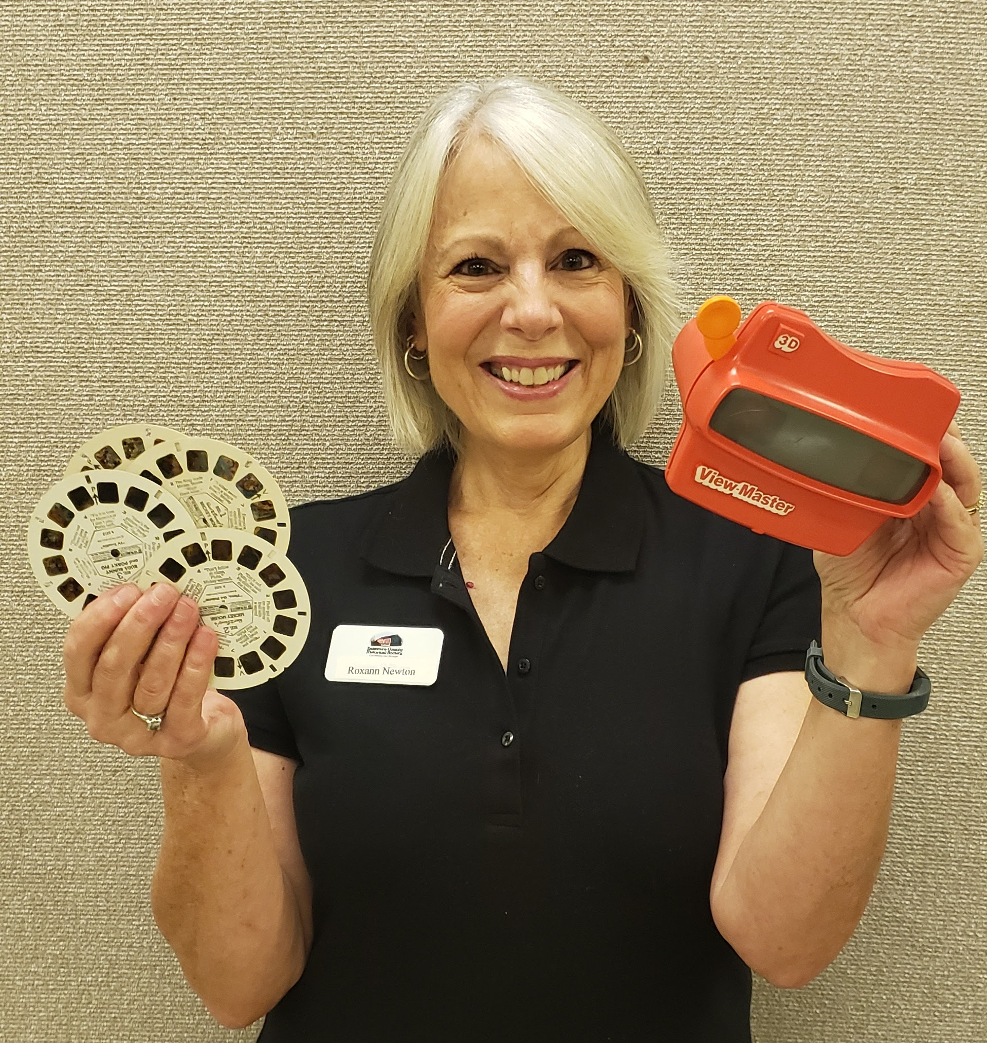
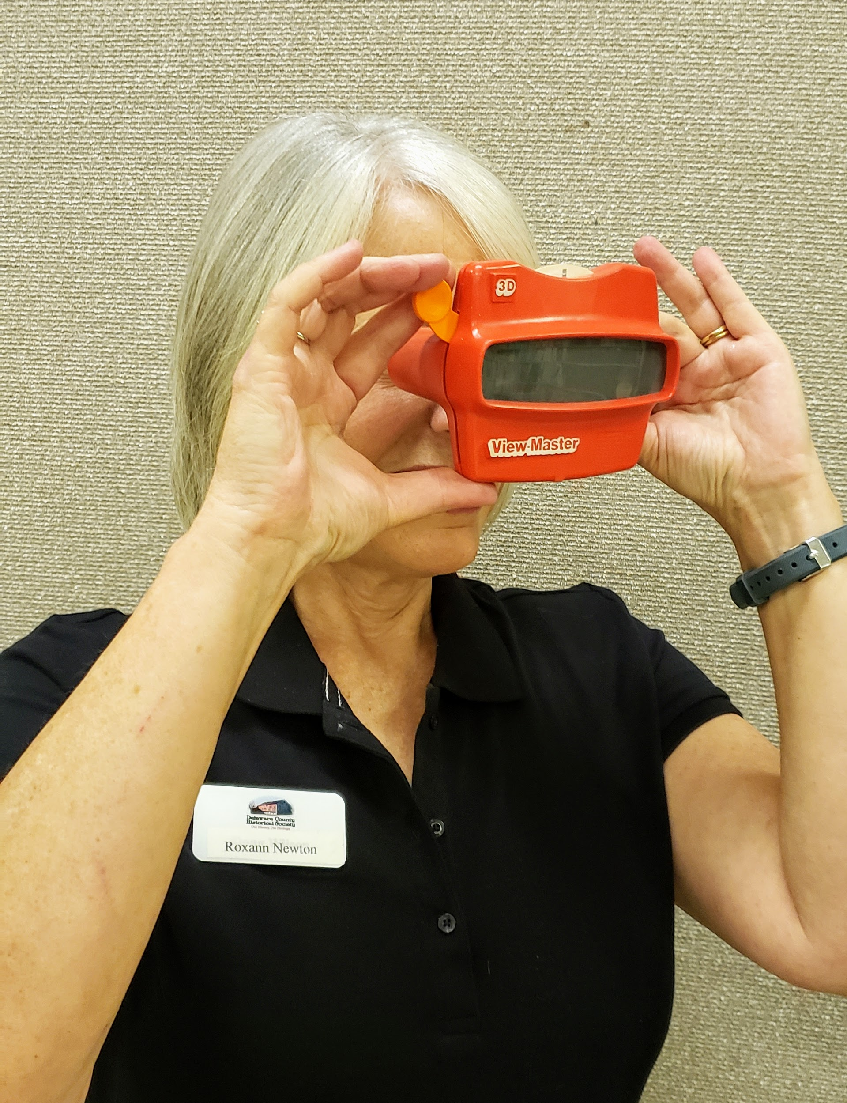
Can you compare this to an artifact you saw?
Notes:
Have you ever seen one of these?

Slide 16
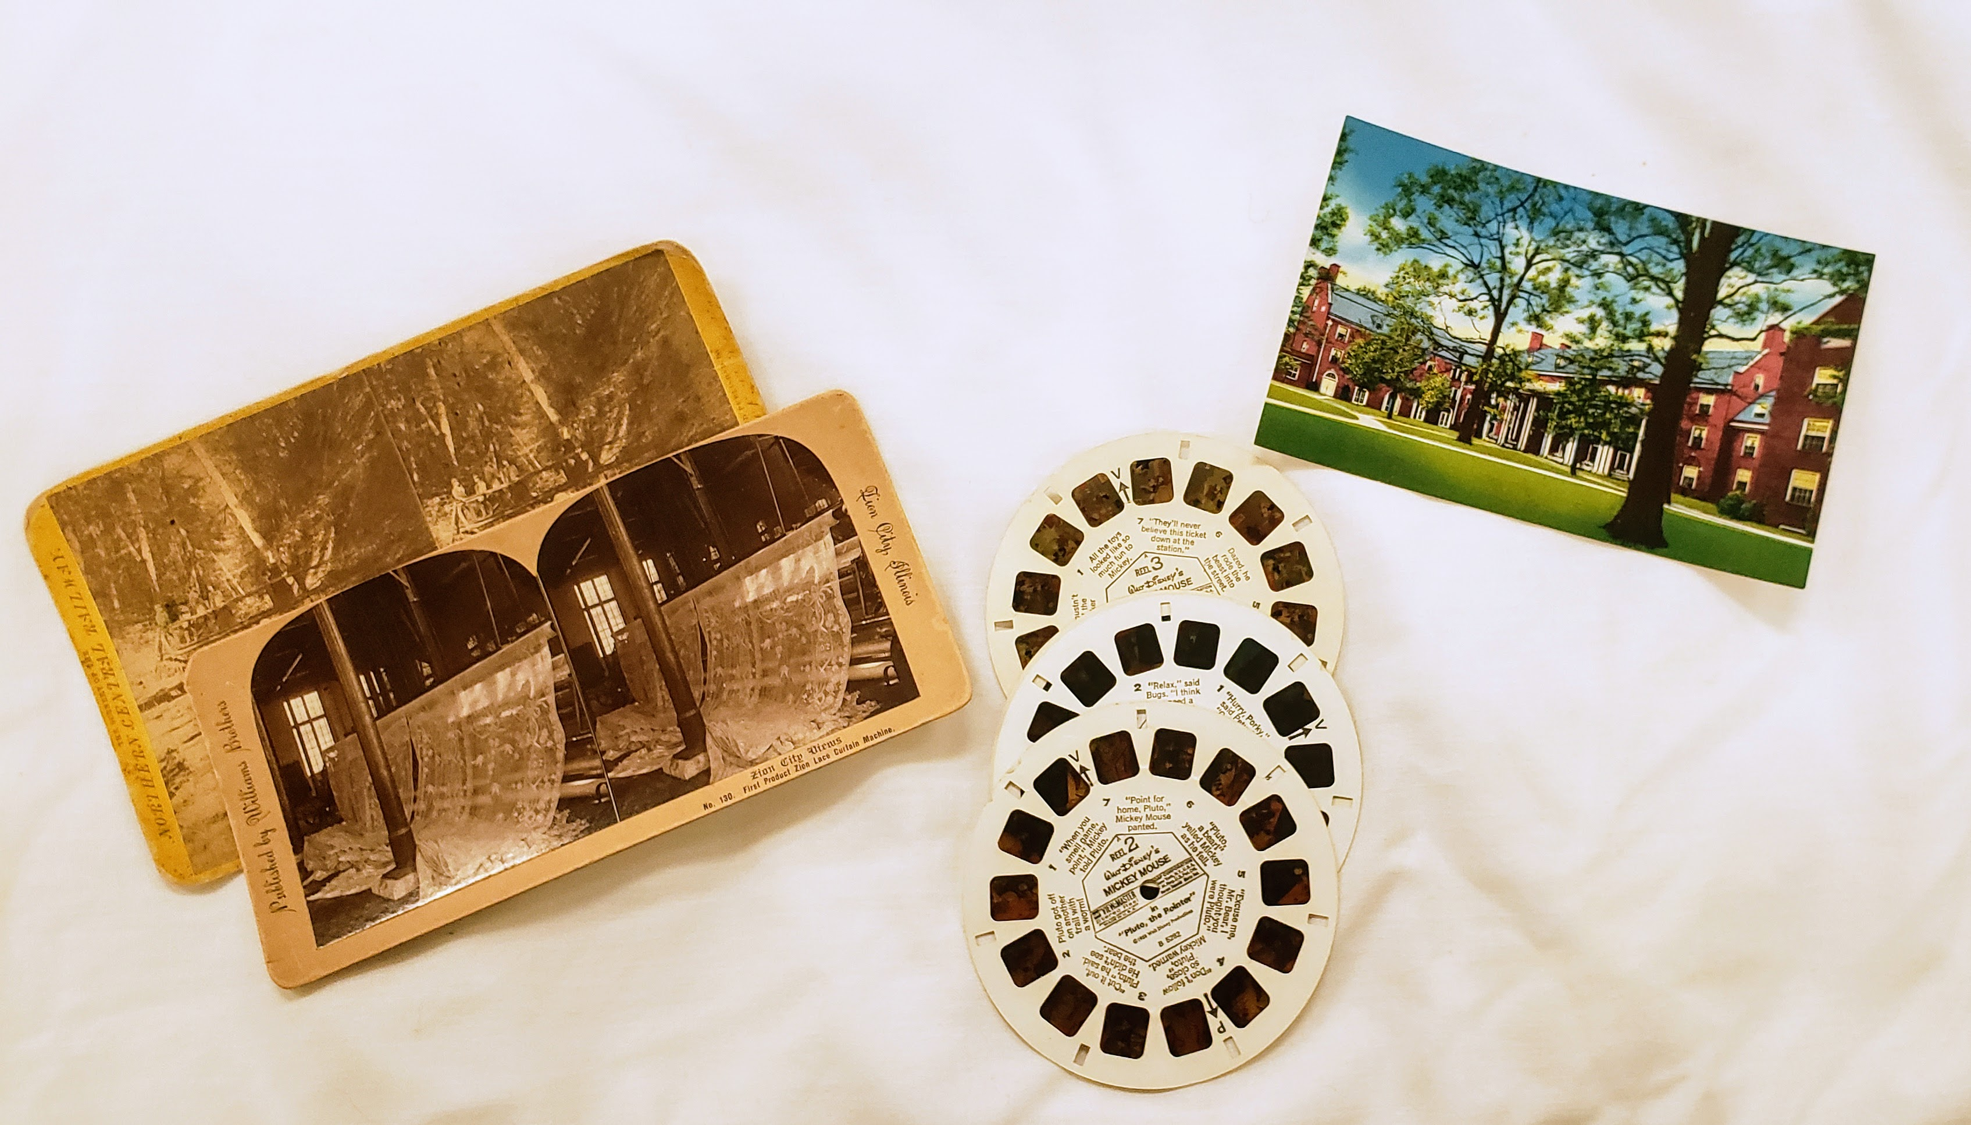
Can you also compare these photos. Which are from the past and which are used today?

Slide 17
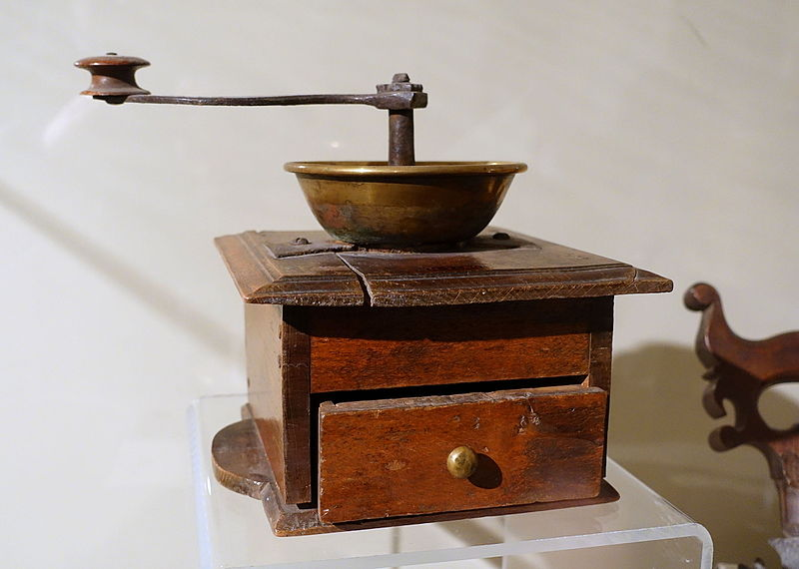
DESCRIBE THE OBJECT
ANALYZE ITS PURPOSE
TELL ITS SOURCE
EXPLAIN ITS MATERIALS
Notes:
Here is our third object. Can you tell what it is? Remember our thinking steps: First, Describe the object. Second, Analyze its purpose or how it was used. Third, Tell its source and fourth, Explain its materials.
https://commons.wikimedia.org/wiki/File:Peugeot_coffee_grinder.jpg

Slide 18
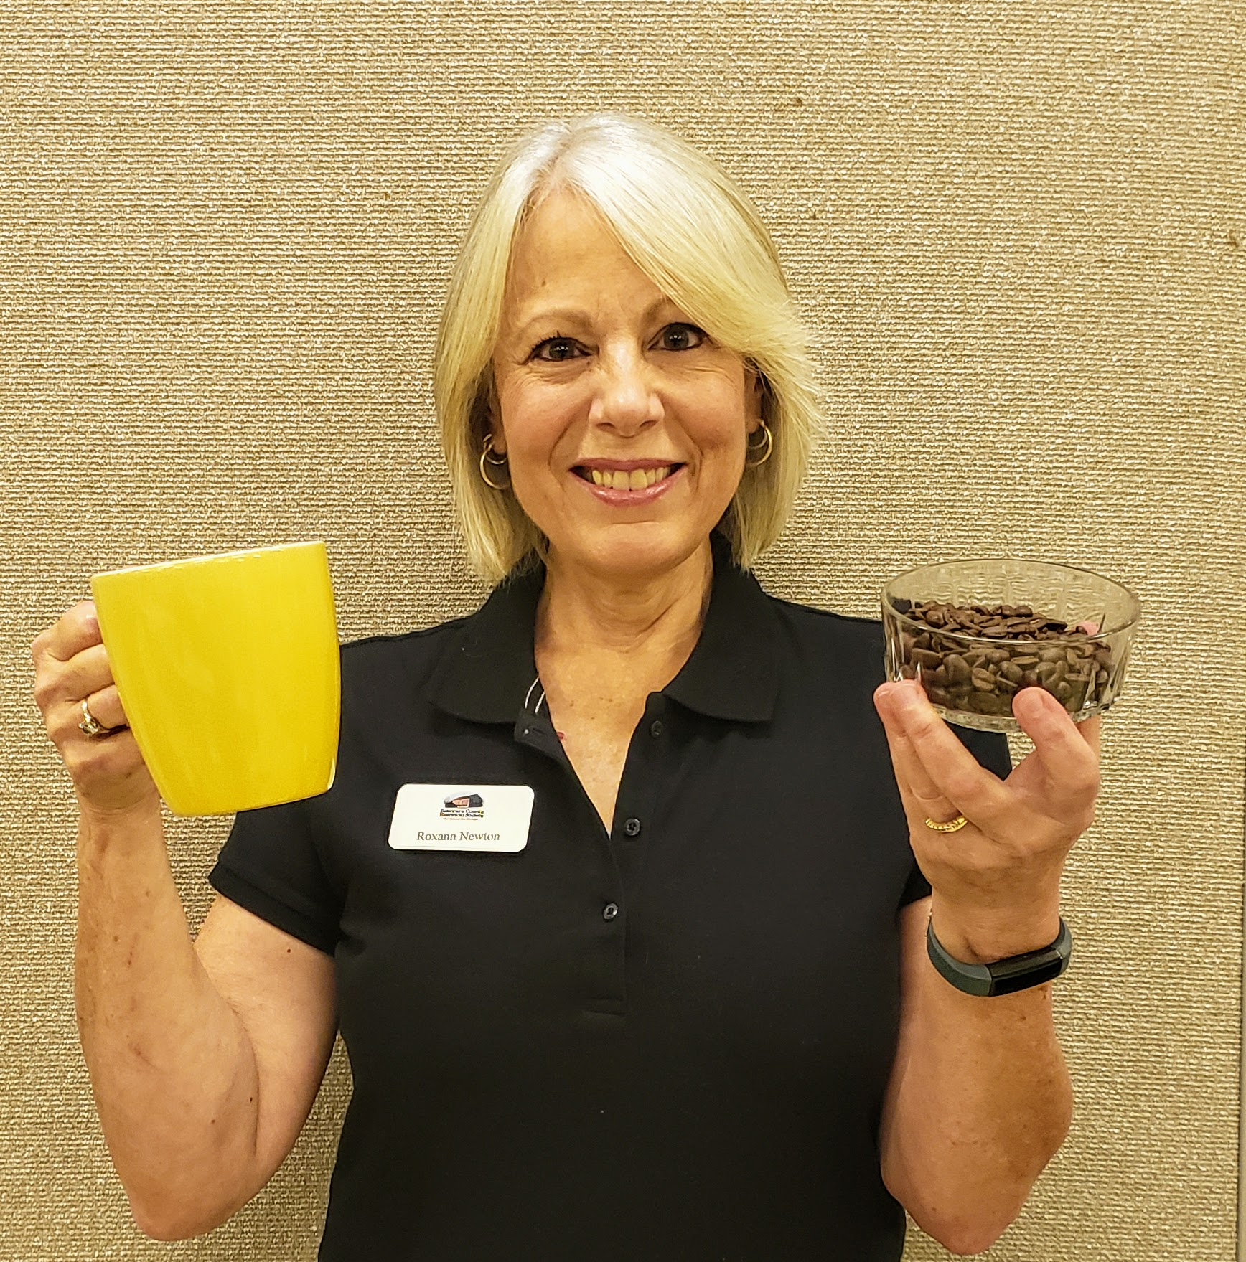
DESCRIBE THE OBJECT
ANALYZE ITS PURPOSE
TELL ITS SOURCE
EXPLAIN ITS MATERIALS
Notes:
Here are some clues.

Slide 19
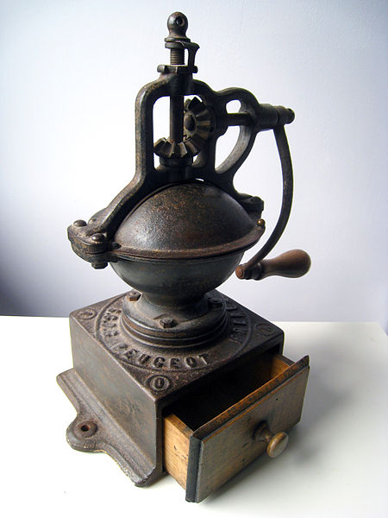
Coffee Grinder
Here is another example of an old coffee grinder.
Notes:
Did you guess that it was a coffee grinder?
https://commons.wikimedia.org/wiki/File:Coffee_mill,_England,_1700s,_iron,_brass,_oak_-_Concord_Museum_-_Concord,_MA_-_DSC05800.JPG

Slide 20
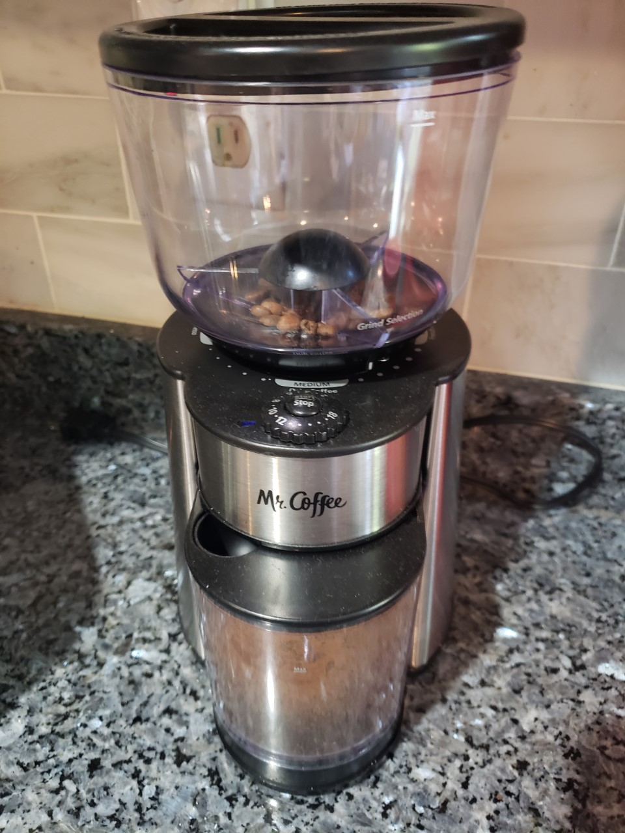
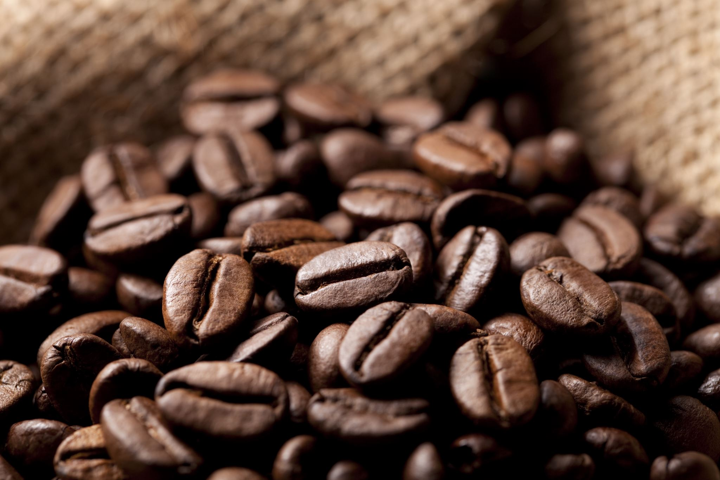
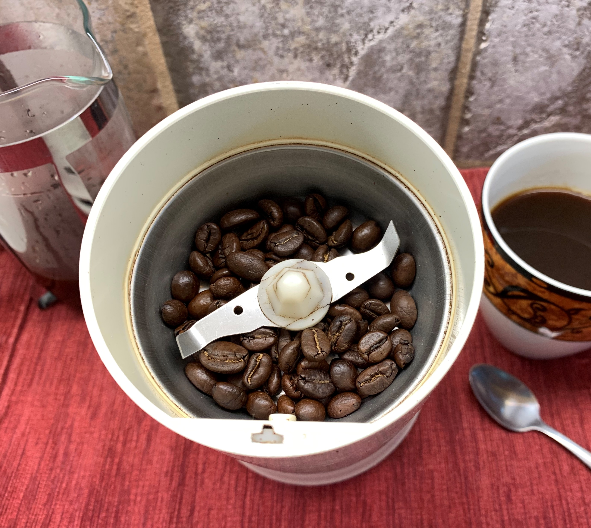
Insert photo of new coffee grinder
Notes:
Here is a modern coffee grinder. Have you seen one of these at your house?
Coffee grinder https://commons.wikimedia.org/wiki/File:Coffee_grinder_blades.jpg

Slide 21
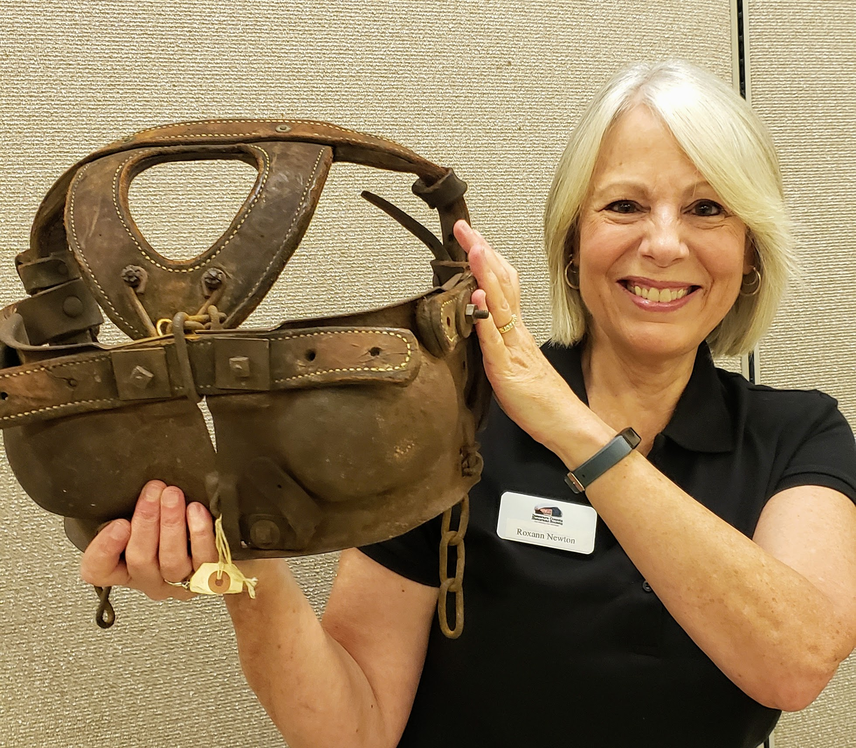
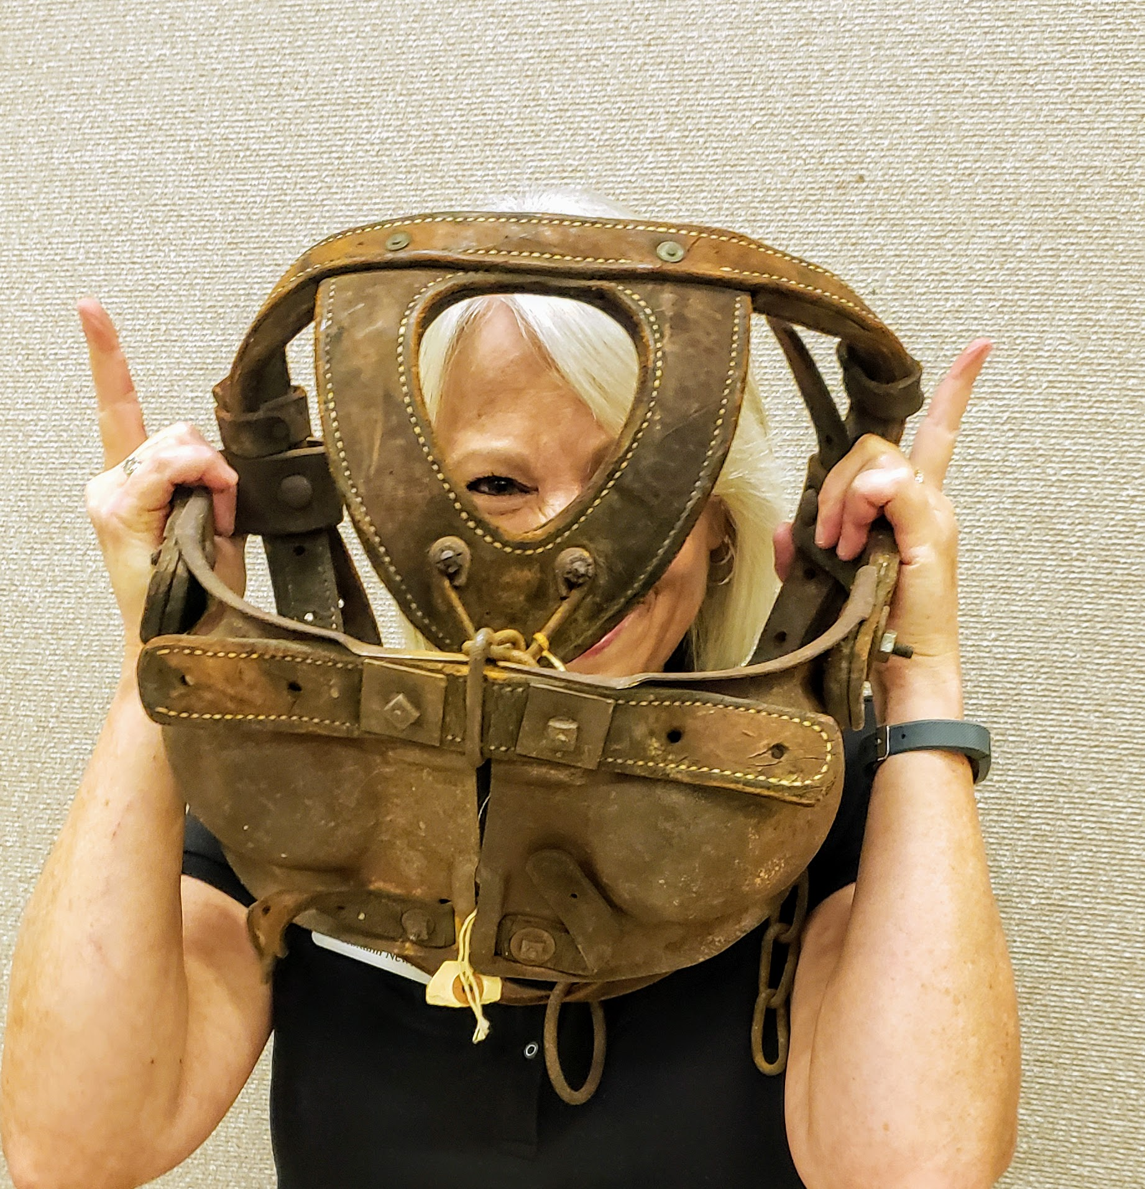
DESCRIBE THE OBJECT
ANALYZE ITS PURPOSE
TELL ITS SOURCE
EXPLAIN ITS MATERIALS
Notes:
This is our fourth artifact. What is it? What are some of your guesses? Let’s go through your thinking steps. Describe the object. Let’s analyze its purpose. Can you tell its source? Can you explain its materials? What is your inference or guess? Let’s look at this second photo. I am showing you some clues to help you guess the artifact.

Slide 22
Bull blinder
With a blinder on, the bull can only see when his head is upright. It was protection for the farmer. The blinder was used to control and/or prevent animals (particularly vicious bulls) from charging persons or other animals.
Notes:
Did you guess a Bull Blinder? (Read the slide.)

Slide 23
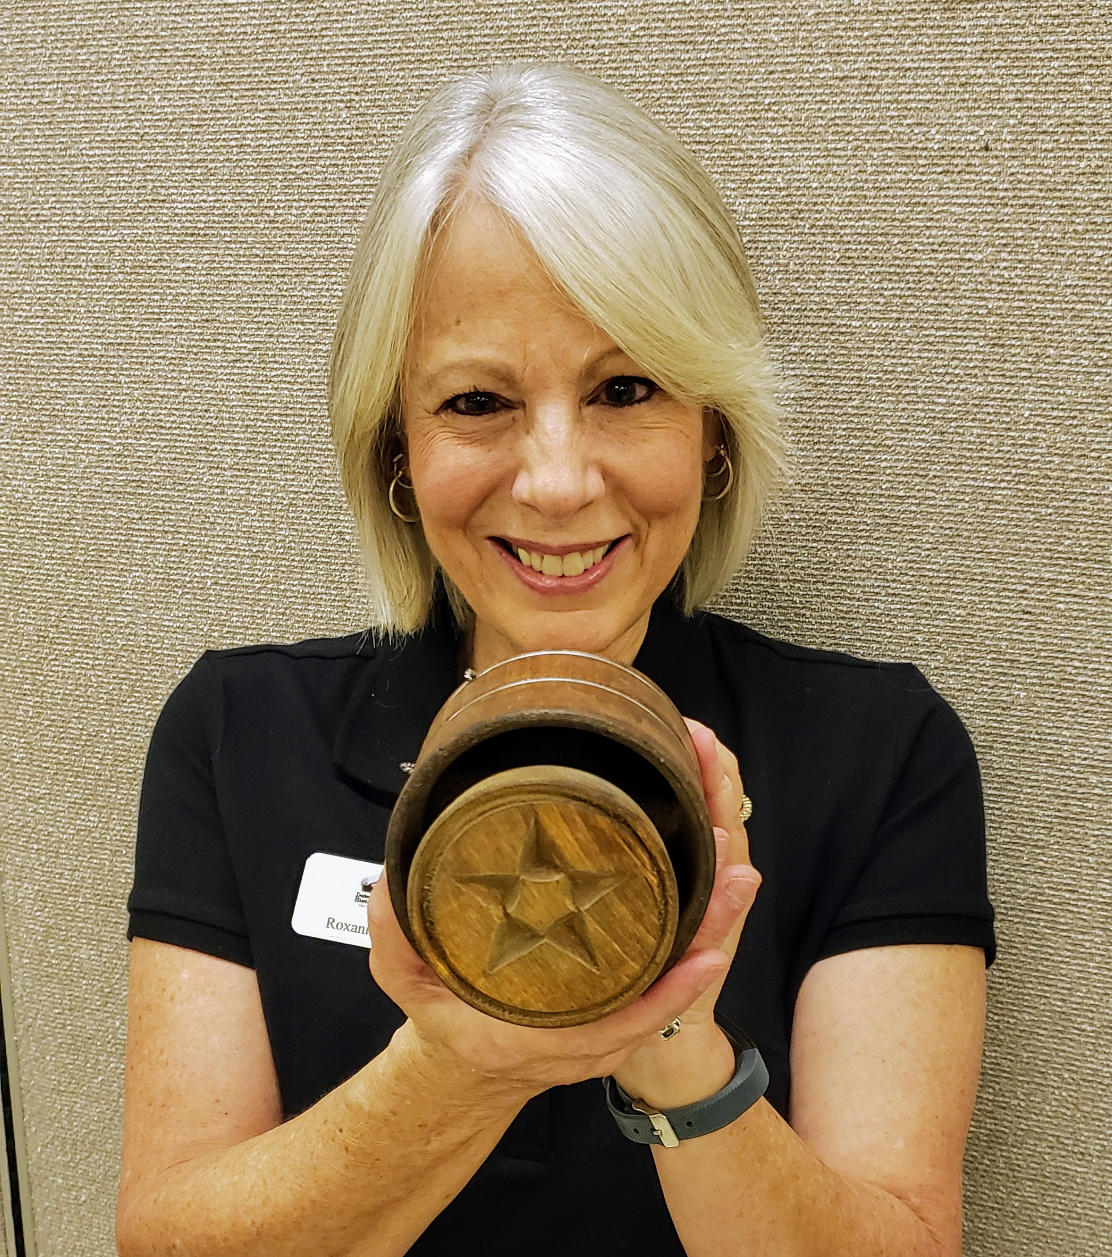
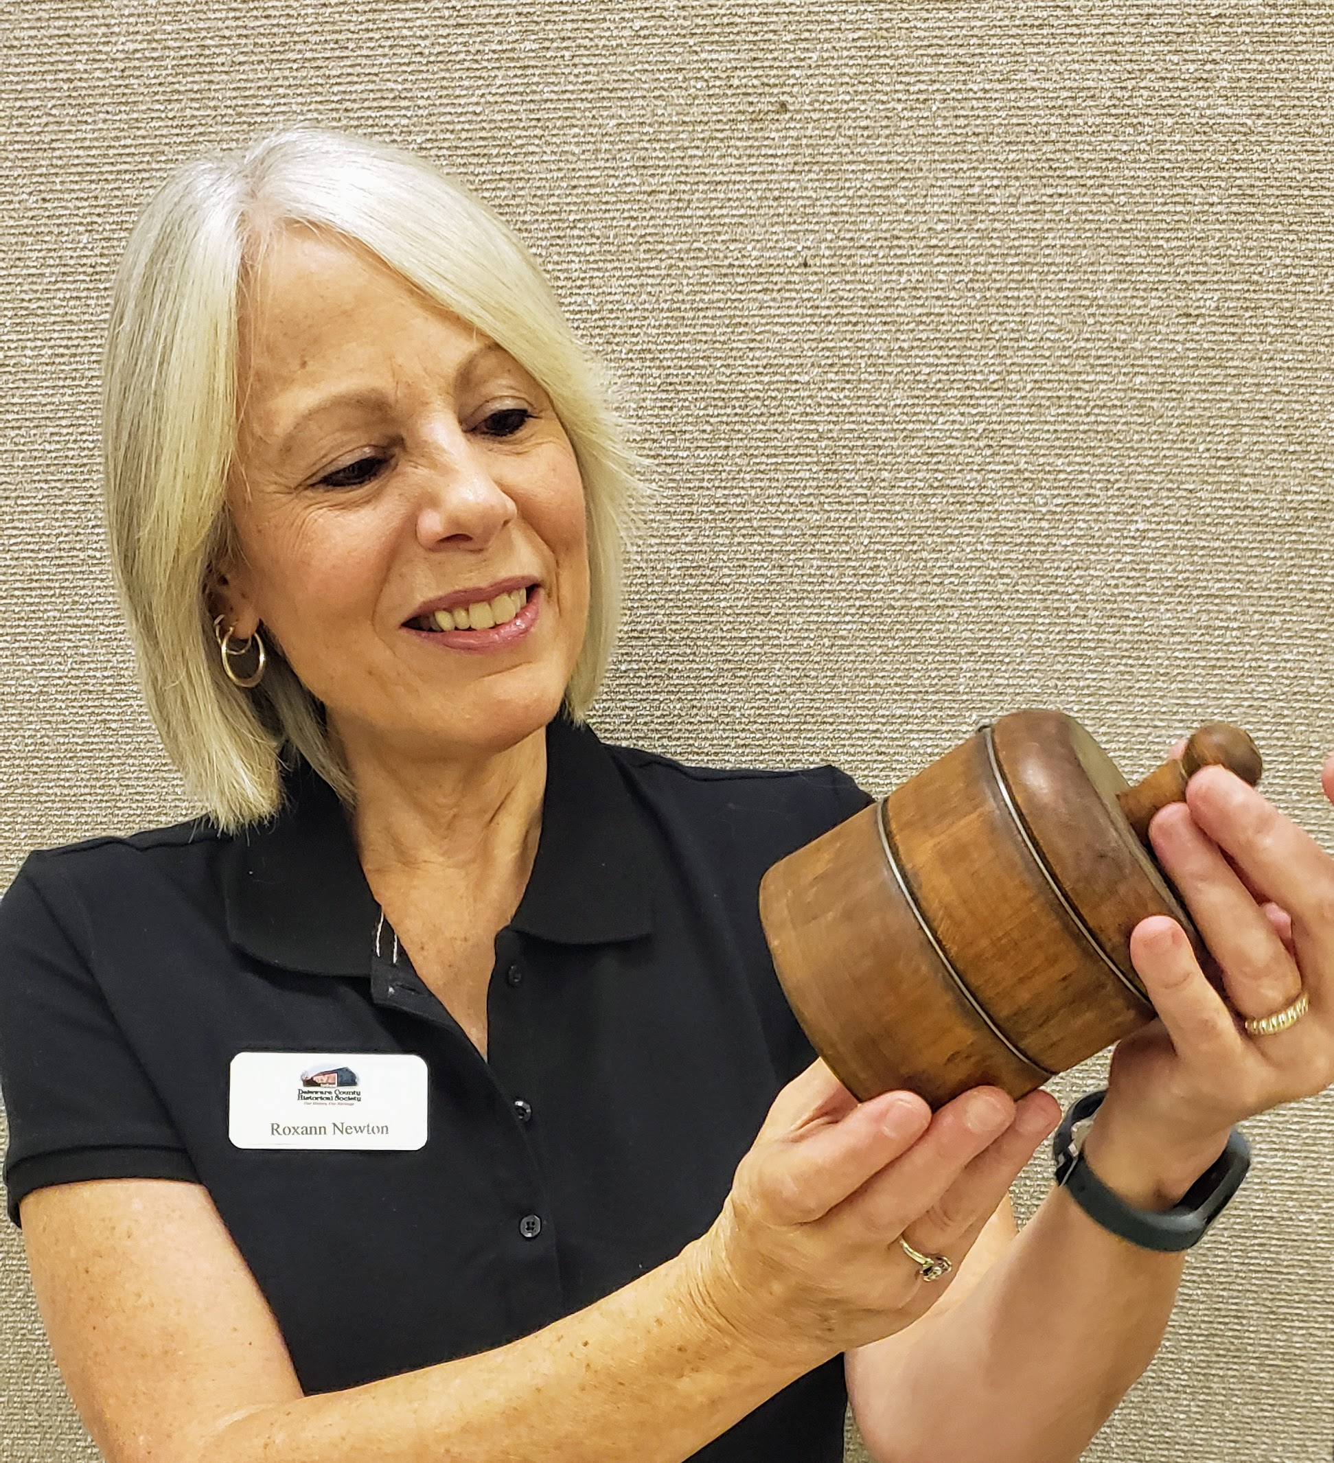
DESCRIBE THE OBJECT
ANALYZE ITS PURPOSE
TELL ITS SOURCE
EXPLAIN ITS MATERIALS
Notes:
Here is the last artifact I want to share with you. What do you think this is? Remember to use the thinking steps. (Read the slide.)

Slide 24
Butter Mold Or Butter press
Butter presses make butter more visually appealing for table use.
When people produce butter, they usually place it in a crock, tub, mold or box. Old, primitive butter mold presses were made from wood and carved with a handle on the top and a flat bottom with a design carved on the underside. People pressed the design onto the top of the butter.
Notes:
Did you guess a butter mold? It is also called a butter press. (Read the slide.)

Slide 25
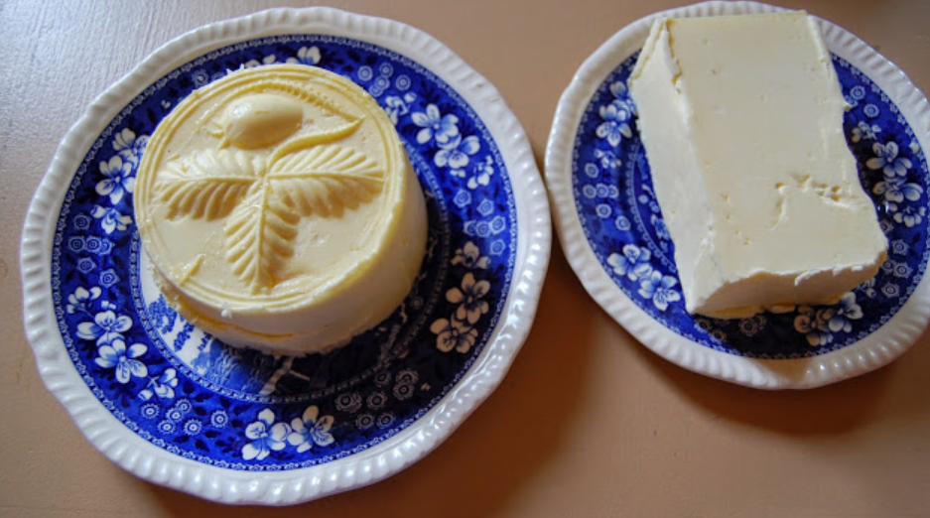
Learn how to mold butter here.
Notes:
To see the process of molding butter click on the link above.
TEACHER NOTES: More information on butter molds https://blog.cheesemaking.com/molding-butter-part-3/

Slide 26
Notes:
Think about the artifacts we have shared with you. Many of them are from the past.

Slide 27
And that’s the way it was.
How are things different today? Can you match the items from long ago to the item today?
Notes:
(Read the slide.)

Slide 28
Sorting Game
Then and Now
Click HERE to play the Game
How are things different today from the past?
Can you match the items from long ago to the item today?
1. Click on the link above.
2. Choose a card with your cursor, then find its match from a different time period. For instance, an image of a kerosene lamp from long ago would be matched with an item that would provide light to people today, such as a table lamp. Have fun!
3. If the two cards match a green frame will appear around each card. The two properly matched cards will disappear when you move to the next card choice.
3. If you want to play again, press the back arrow at the top to shuffle the cards and try again.
Notes:
Here is a fun sorting game we think you will like. See if you can match the objects from Long Ago or Then, to objects we Use Today, or Now. You will click the blue colored instruction that says, “Click Here to play the Game.” When you click on two objects that you think match, the area around the objects will turn green if you are correct, or red if your guess is wrong. And don’t forget that once you match an object that was used ‘Then’ to an object that is used ‘Now,’ be sure to remove it from the game by clicking again. This will help you! Good luck!“

Slide 29
Think about items you use everyday, like a pencil. Did students in third grade always write or draw with pencils? If not, what did they use?
Make a chart of Then and Now items.
Draw a picture for each Then and Now item.
Write a story about the Then and Now items.
This Photo by Unknown Author is licensed under CC BY-SA-NC
Notes:
Here is something you might do. (Read the slide.)

Slide 30
Then Now
80º
August 5, 2020
Notes:
Here is an example of a Then and Now activity. Draw a picture of an item from Then or from the past. Next, draw a picture of the item from Now or today. Include several details in your drawing.

Slide 31
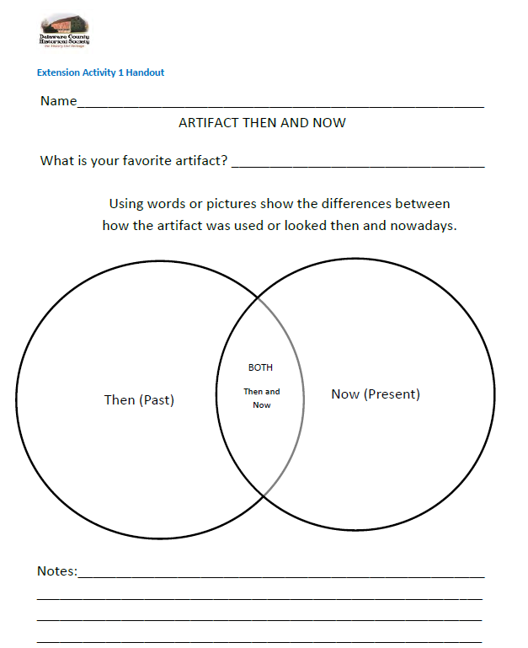
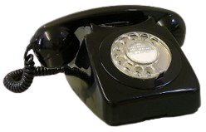
Then
Now
Then and Now Venn Diagram
cord
black
dial shiny buttons
two parts connected ring tones apps
with a cord phone calls camera
Notes:
LAURIE Here is another way of comparing objects of the past, or Then, to objects of the present, or Now. The light blue circle above the old-fashioned telephone shows characteristics of the object from Then. It has a dial and two parts that are connected with a cord. The light blue circle above the cell phone which we use now has buttons, apps and a camera. Now look at where they overlap. These are the characteristics that they have in common. They both use a cord, they can be black and shiny, and have ring tones, and they both make phone calls. Think about what you might write as attributes or characteristics for each of the Then and Now artifacts.
TEACHER NOTES:
Ohio English Language Arts Learning Standards- Grade 1 –Attributes
Ohio Social Studies Learning Standards- Grades 1-3- Characteristics

Slide 32
Check your local library, at school, or online for more books about artifacts, old photographs, old texts, or archeology.
Notes:
(Read the slide.)

Slide 33
Respect the Past
Create the Future
Notes:
All together. (Each person reads a phrase.)

Slide 34
Thank you for visiting the Delaware County Historical Society Curriculum Resources.
Donations are greatly appreciated and allow us to continue to operate our historical sites, research library, and educational resources like this.
Contact us at Info@DelawareOhioHistory.Org
Notes:
ROXANN Those are all the artifacts we have to share with you today, but we have many more at the Delaware County Historical Society to view. We hope you will come and visit us at our two museums some day soon! In the meantime, look around your home and see if you have any man-made objects that give clues about YOUR life!
Goodbye!

Slide 35
Support the Delaware County Historical Society
The Delaware County Historical Society is supported by dues, grants, donations and volunteers. We welcome your help with any of our worthwhile projects:
Donate money https://delawareohiohistory.org/financial-donation/
Become a member https://delawareohiohistory.org/join-us/

